Slide 1
TMS
Dhruvanshi Ghiya

Slide 2
TMS: Transportation Management System : Prototype
Key Features:
Windows Presentation Foundation GUI Application
MySQL Database Backend
Three Main User Roles
Admin
Buyer
Planner

Slide 3
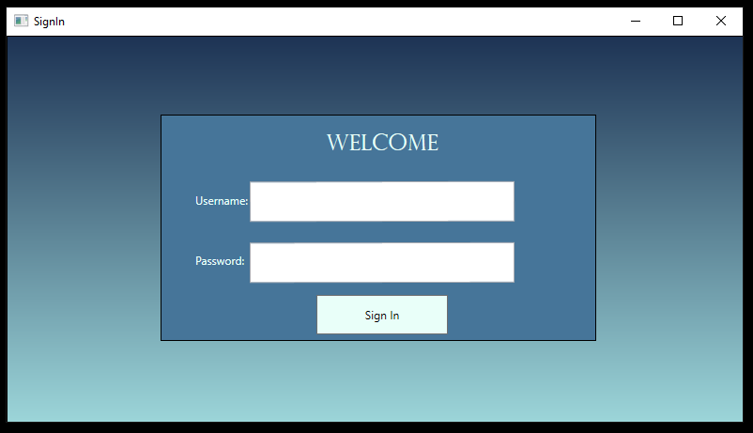
Overview

Slide 4
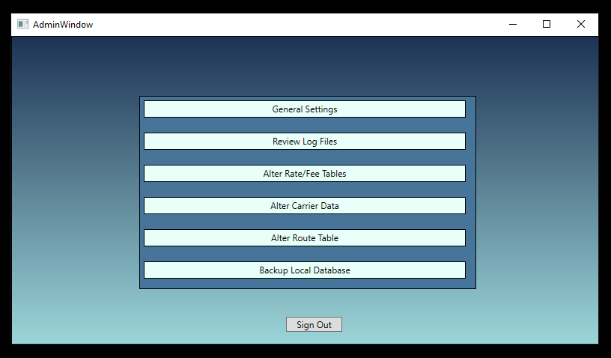
Admin

Slide 5
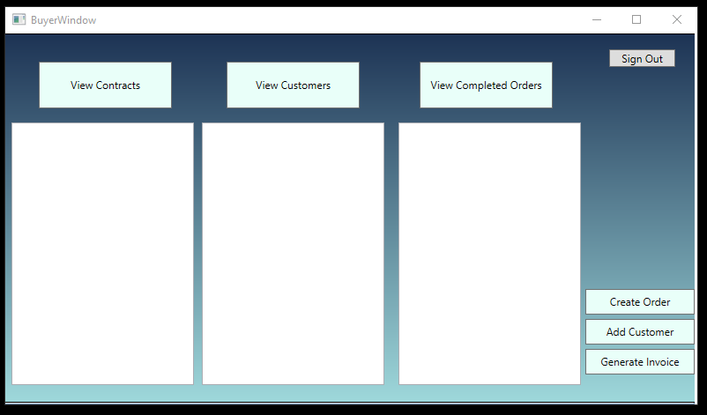
Buyer

Slide 6
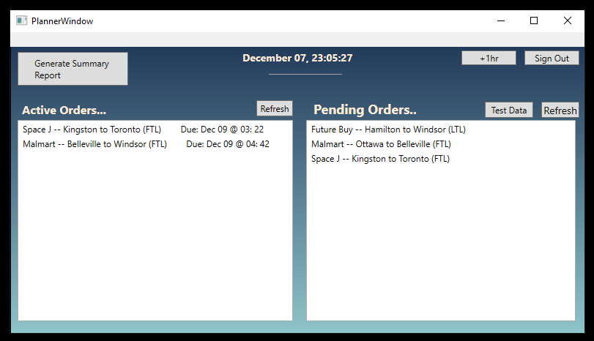
Planner

Slide 7
Data Protection
Key Features:
The TMS database is password protected (admin access only)
TMS users have limited DB access (CRUD only)
Backups performed and kept
Database operations are handled by a single class
App requires verified user to login

Slide 8
Support Features
Key Features:
Logs of errors are kept for troubleshooting
The admin can view log files ensure proper functioning
Intuitive UI which is easy to use

Slide 9
Non-Functional Features
Key Features:
All screens and workflows load and respond quickly
Clean and intuitive UI
No data loss; secure database
All code efficiently commented
Not too many screens

Slide 10
Github Repo
https://github.com/travisf131/TMS-Solution-Group-10

Slide 11
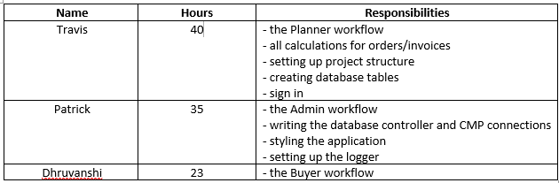
Work breakdown
Milestone 4

Slide 12
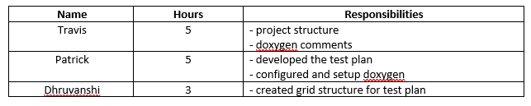
Work breakdown
Milestone 3

Slide 13
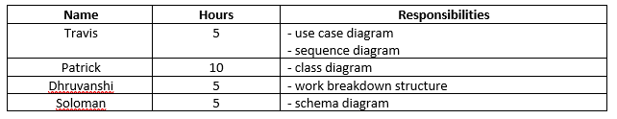
Work breakdown
Milestone 2

Slide 14
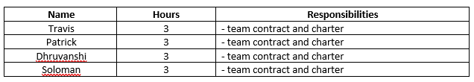
Work breakdown
Milestone 1

Slide 15
Resources
SQ-TermProjectOverview(2021). Retrieved 8 December 2021, from https://conestoga.desire2learn.com/d2l/le/content/482677/viewContent/9959522/View

